Slide 1
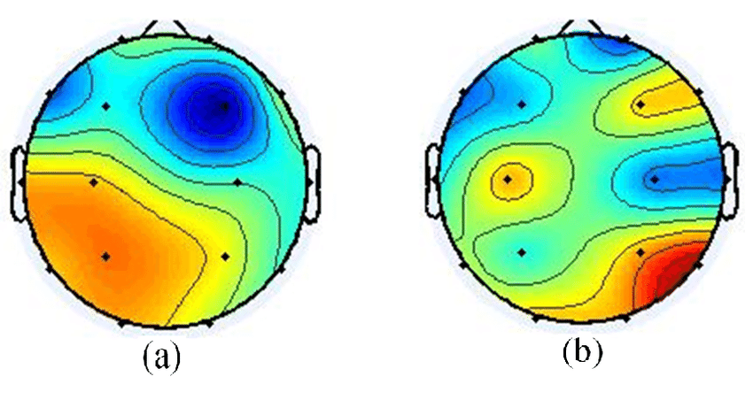
ICA overview
EEG Working Analysis Group
October 28th, 2021
Olivia Stibolt and George Buzzell

Slide 2


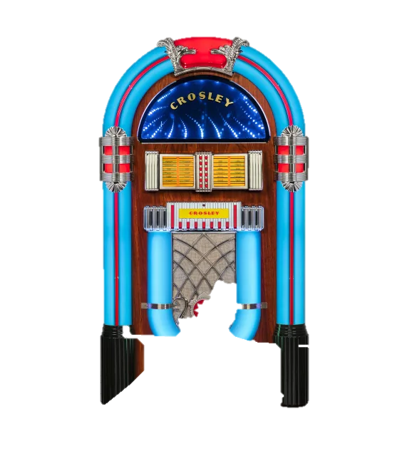

Slide 3
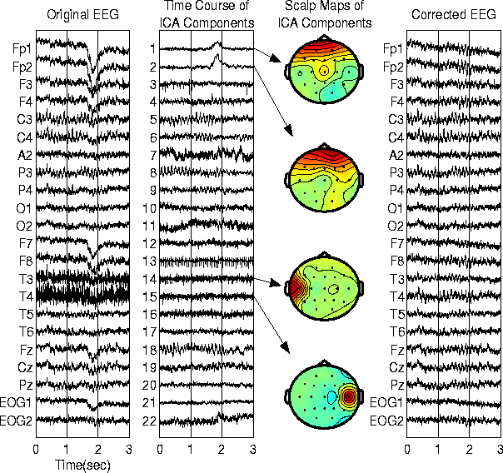
Input from multiple microphones
Isolated conversations with music
Room locations
Combined conversations without music
https://cnl.salk.edu/~jung/artifact.html

Slide 4
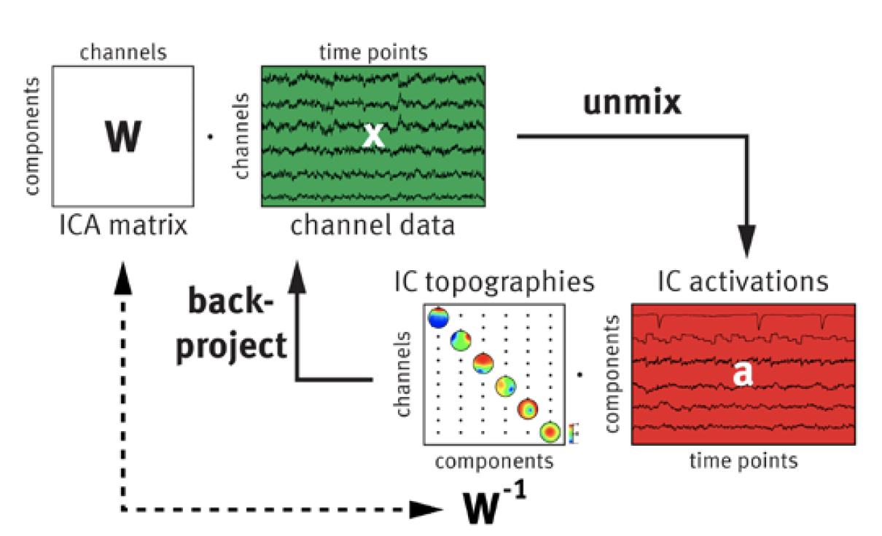
What exactly is Independent Components Analysis (ICA)?
ICA separates the data into components that are as statistically independent
The occurrence of one component doesn’t predict any others
Each component is collection of the signals that ICA thinks come from the same thing
ICA does this by creating an unmixing matrix
https://pressrelease.brainproducts.com/independent-component-analysis-demystified/

Slide 5
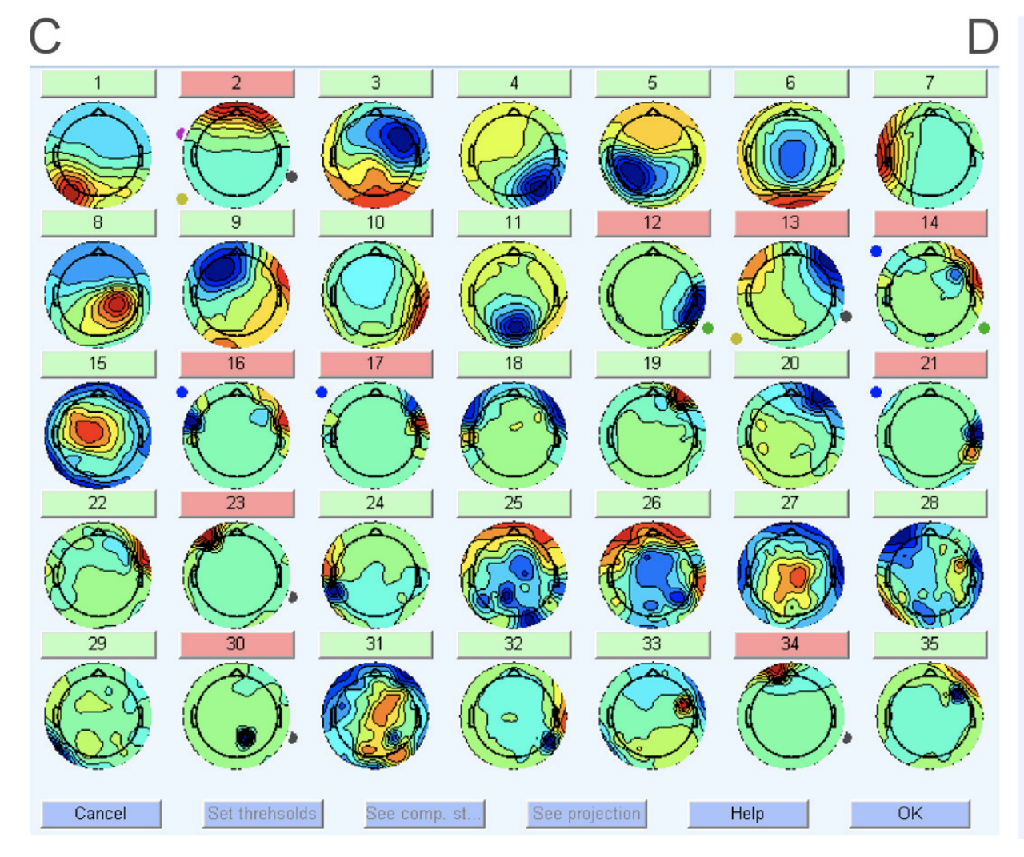
Chaumon, M., Bishop, D. V. M., & Busch, N. A. (2015). A practical guide to the selection of independent components of the electroencephalogram for artifact correction. Journal of Neuroscience Methods, 250, 47–63. https://doi.org/10.1016/j.jneumeth.2015.02.025

Slide 6
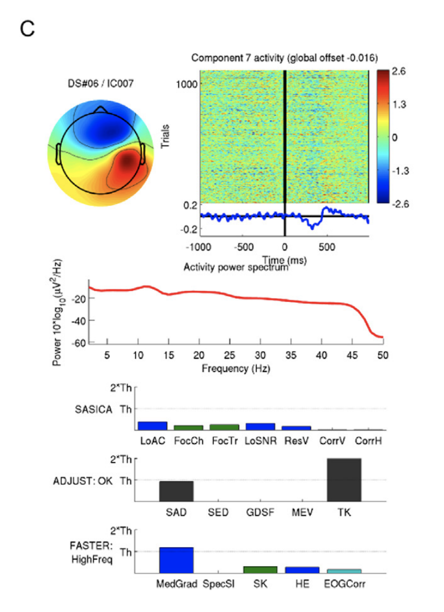
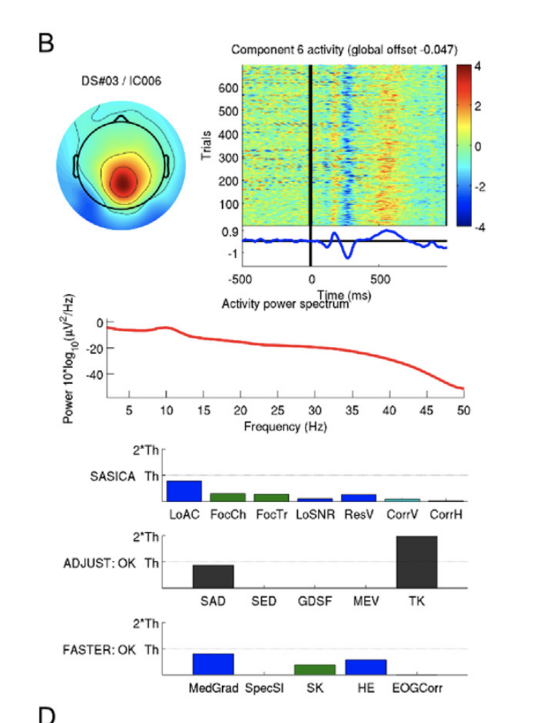
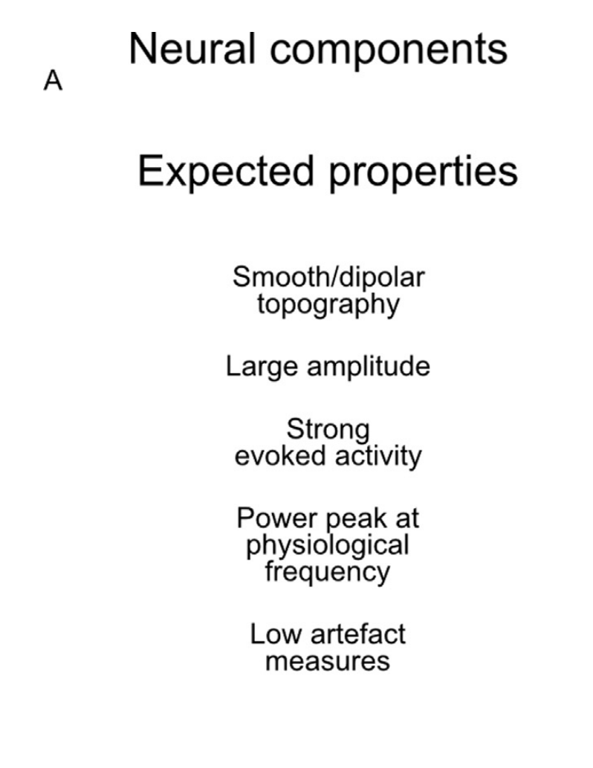
Neural Components in SASICA
Chaumon, M., Bishop, D. V. M., & Busch, N. A. (2015). A practical guide to the selection of independent components of the electroencephalogram for artifact correction. Journal of Neuroscience Methods, 250, 47–63. https://doi.org/10.1016/j.jneumeth.2015.02.025

Slide 7
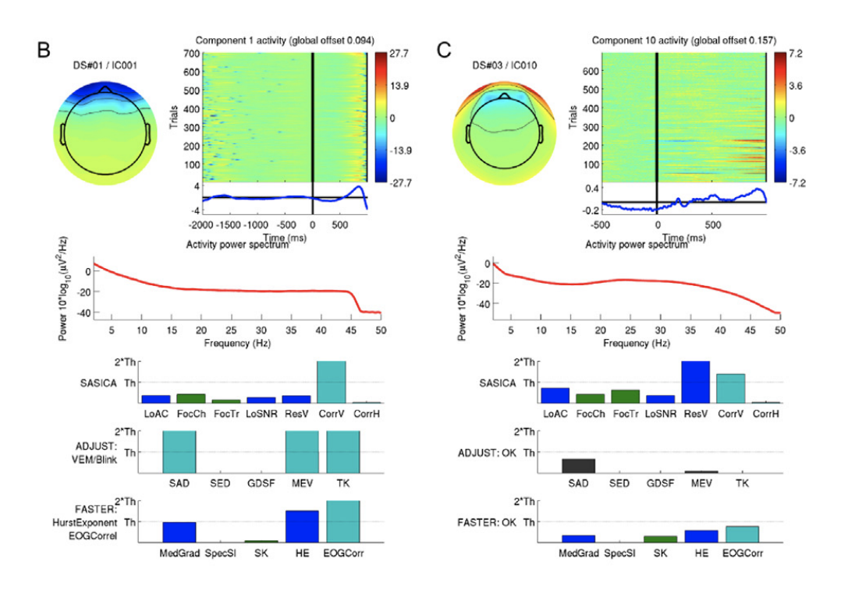
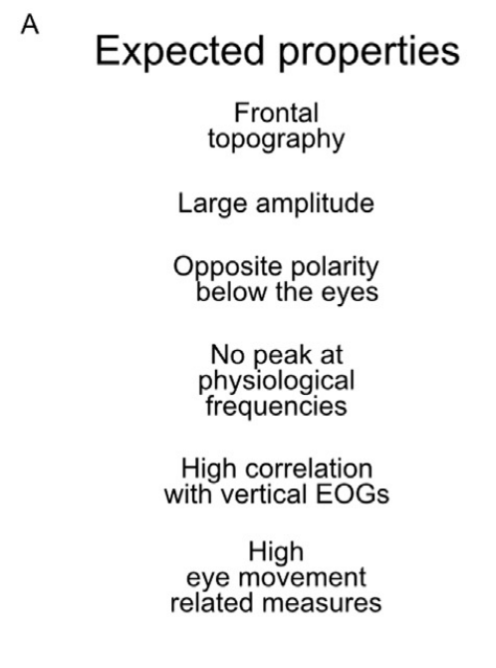
Blinks in SASICA
Chaumon, M., Bishop, D. V. M., & Busch, N. A. (2015). A practical guide to the selection of independent components of the electroencephalogram for artifact correction. Journal of Neuroscience Methods, 250, 47–63. https://doi.org/10.1016/j.jneumeth.2015.02.025

Slide 8
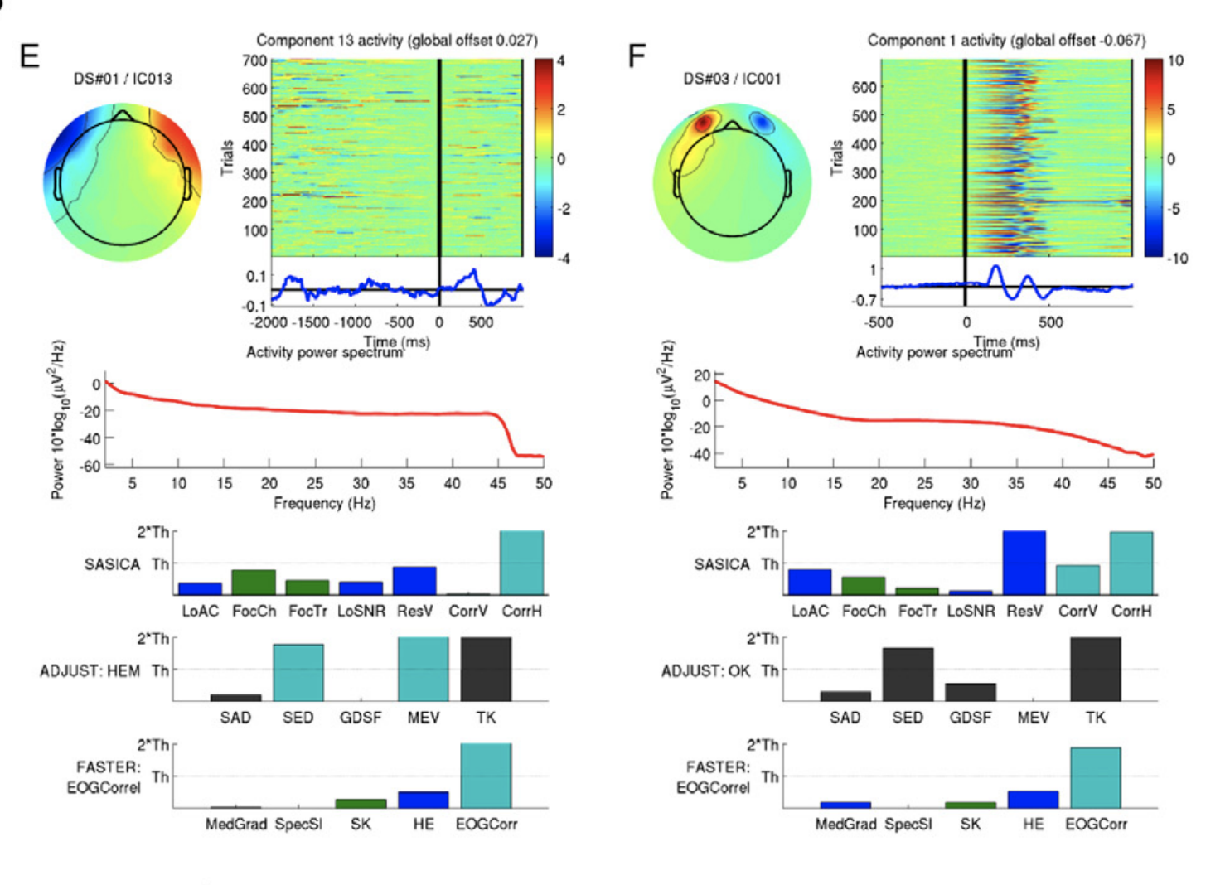
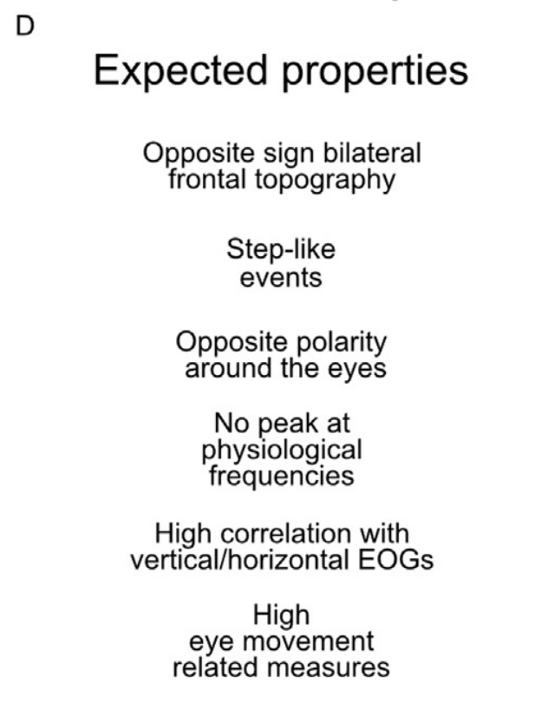
Horizontal Eye Movements in SASICA
Chaumon, M., Bishop, D. V. M., & Busch, N. A. (2015). A practical guide to the selection of independent components of the electroencephalogram for artifact correction. Journal of Neuroscience Methods, 250, 47–63. https://doi.org/10.1016/j.jneumeth.2015.02.025

Slide 9
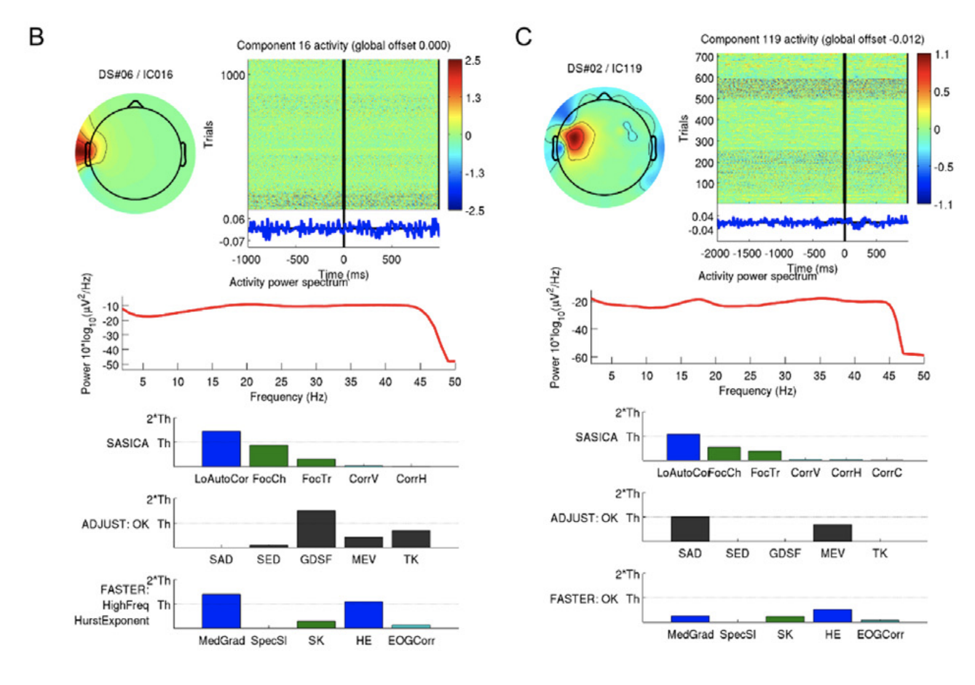
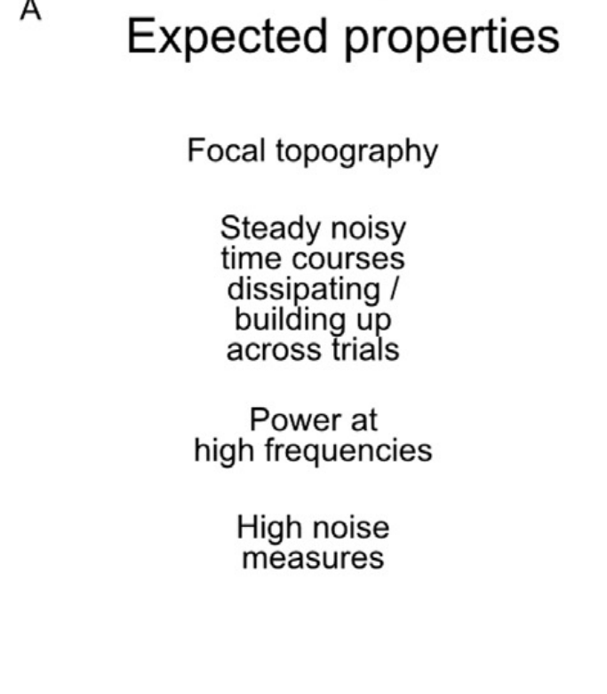
Muscle Movement in SASICA
Chaumon, M., Bishop, D. V. M., & Busch, N. A. (2015). A practical guide to the selection of independent components of the electroencephalogram for artifact correction. Journal of Neuroscience Methods, 250, 47–63. https://doi.org/10.1016/j.jneumeth.2015.02.025

Slide 10
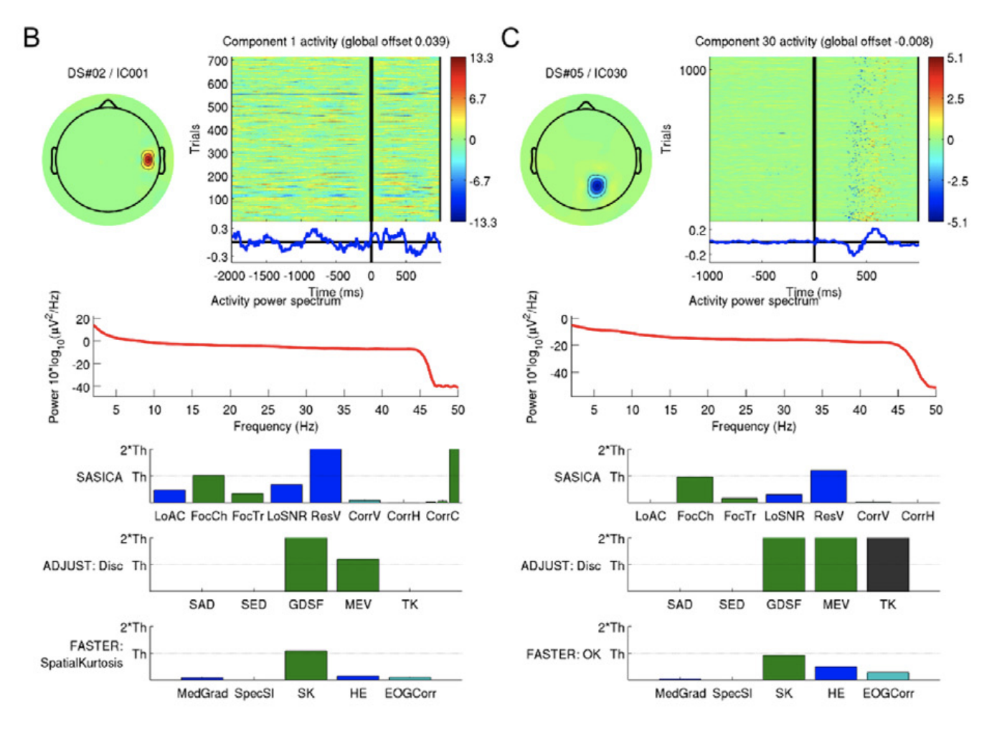
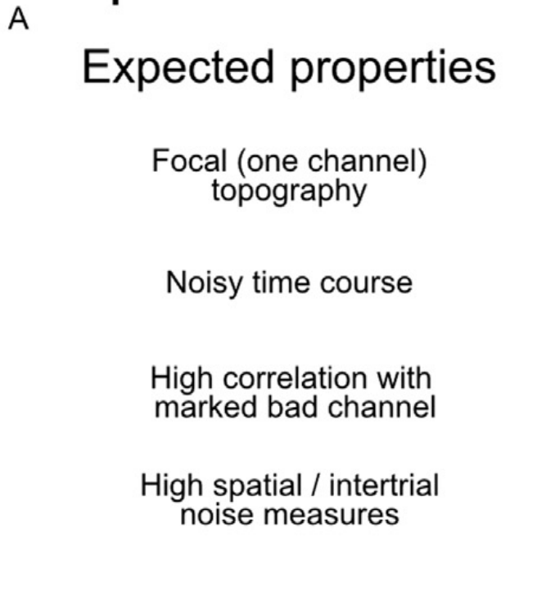
Bad Channels in SASICA
Chaumon, M., Bishop, D. V. M., & Busch, N. A. (2015). A practical guide to the selection of independent components of the electroencephalogram for artifact correction. Journal of Neuroscience Methods, 250, 47–63. https://doi.org/10.1016/j.jneumeth.2015.02.025

